Slide 1
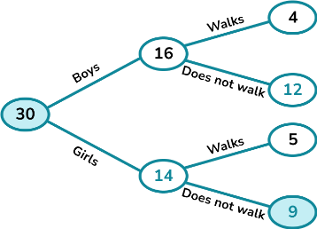
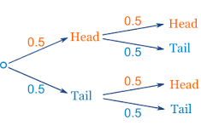
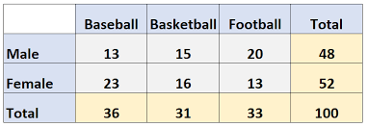

Subtopic N2.15 – Solve Problems with Frequency Trees
LEARNING OUTCOME: To understand and use frequency trees.
Keywords:
Frequency
Sum
Difference
Objectives:
Populate partially completed tree diagrams.
Construct tree diagrams from given information.
Use a frequency tree to answer questions.
Introduction – Read and annotate:
In this topic, you will work with frequency tables, which are a way of organising information to show
how often something happens. Reading and interpreting these tables is an application of basic
addition and subtraction, as you will often need to total frequencies, compare amounts, or find
differences. This helps you make sense of data in a clear and structured way.
Definition
Characteristics
A diagram which shows the number of times something occurs in given categories.
Contains branches and circles, where all of the subcategories emanating from a particular circle must sum to the shown value.
Examples
Frequency Tree
Non - Examples
Populating missing values in frequency trees
Example 1 - I do…
Example 2 – We do…
Steps | Complete the following frequency tree | Complete the following frequency tree
1) Use the rules of addition and subtraction to calculate the missing values.
glasses
Circle
29
21
Y7
40
Blue
56
11
35
no glasses
Triangle
100
266
glasses
Circle
Y8
23
Green
115
60
210
37
95
no glasses
Triangle
Example 3 – You do…
Steps | Complete the following frequency tree
1) Use the rules of addition and subtraction to calculate the missing values.
History
77
Y10
165
Geography
88
320
History
Y11
100
155
55
Geography

Slide 2
Independent Practice
1. Complete the following frequency trees.
a)
white bread
b)
white bread
51
13
72
88
ham
21
tuna
75
brown bread
brown bread
100
250
white bread
3
white bread
46
cheese
28
chicken
162
brown bread
25
brown bread
116
c)
d)
Late
Gym
61
22
121
30
Saturday
60
Snow
8
Swimming
On Time
255
210
Gym
80
Late
31
Sunday
134
No Snow
180
Swimming
54
On Time
149
e)
Did homework
f)
Pass
40
40
70
More than 10 lessons
51
Y10
30
11
No homework
Fail
300
130
Did homework
100
Pass
12
Y11
230
Less than 10 lessons
79
No homework
130
Fail
67

Slide 3
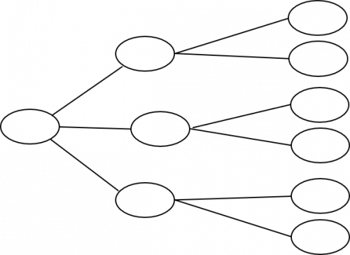
g)
white bread
h)
Spanish
10
139
Salmon
64
260
54
Y10
121
brown bread
French
120
520
white bread
53
Spanish
89
Beef dripping
56
Y11
260
brown bread
3
French
171
i)
j)
Late
Bowling
54
19
101
56
Saturday
47
Rain
37
Golf
On Time
366
147
Bowling
142
Late
11
Sunday
265
No Rain
91
Golf
123
On Time
80
k)
l)
Present
29
Present
27
30
1
Class D
30
Absent
3
Class A
Absent
Class B
Present
27
Class E
Present
25
85
29
92
30
5
Absent
2
Absent
Class C
Present
Class F
32
Present
6
26
20
Absent
6
Absent
26

Slide 4
Generating frequency trees from given information
Example 4 - I do…
Steps | Create a frequency tree for the following information
1) Draw a frequency tree.
2) Fill in the known information.
3) Use addition and subtraction to calculate the missing values.
50 children audition for the school play.
18 of the children are boys.
15 children were given a role in the play.
8 girls were given a role in the play.
Given a role
7
Boys
18
Not given a role
11
50
Given a role
8
Girls
32
Not given a role
24
Example 5 – We do…
Steps | Create a frequency tree for the following information
1) Draw a frequency tree.
2) Fill in the known information.
3) Use addition and subtraction to calculate the missing values.
200 students were given some homework.
102 of these students are in Year 11.
182 of the 200 students did their homework.
14 of the Year 10 students did not do their homework.
Did homework
84
Y10
98
Did not do homework
14
200
Did homework
98
Y11
102
Did not do homework
4
Example 6 – You do…
Steps | Create a frequency tree for the following information
1) Draw a frequency tree.
2) Fill in the known information.
3) Use addition and subtraction to calculate the missing values.
83 people are offered a choice of soup and roll.
9 of the 37 people who had tomato soup had a brown roll.
31 people had chicken soup and a white roll.
Brown roll
9
Tomato
37
White roll
28
83
Brown roll
Chicken
15
46
31
White roll

Slide 5
Independent Practice
2. Create a frequency tree for each of the following questions.
a)
100 students had some homework.
42 of these students are boys. 8 of the 100 students did not do their homework.
53 of the girls did do their homework.
Did homework
39
Boys
42
Did not do homework
3
100
Did homework
53
Girls
58
Did not do homework
5
b)
50 people took a test. Before the test, they predicted whether they would pass or fail.
30 people predicted they would pass. 26 of the people who predicted they would pass did pass.
37 people passed altogether.
Actual Pass
26
Predicted Pass
30
Actual Fail
4
50
Actual Pass
11
Predicted Fail
20
Actual Fail
9
c)
A class has 30 children.
There are 16 boys.
4 girls and 5 boys walk to school, the rest used a car.
Walk
5
Boys
16
Car
11
30
Girls
Walk
4
14
Car
10
There are 150 pupils in Year 10. Pupils either have school lunches or packed lunches.
79 of the pupils are boys. 45 girls have school lunches and 39 boys have school lunches.
d)
School lunch
39
Boys
79
Packed lunch
40
150
School lunch
45
Girls
71
Packed lunch
26

Slide 6
e)
There are 95 cars in a car park.
25 of the cars are white. 13 of the non-white cars are convertibles and 21 of the white cars are not convertibles.
Convertible
4
White
25
Not convertible
21
95
Convertible
13
Not white
70
Not convertible
57
f)
500 people were surveyed. All of the people were either left handed or right handed.
53 of the people are left handed.
26 males are left handed. 231 of the people are male.
Left handed
26
231
Male
Right handed
205
500
Female
Left handed
27
269
Right handed
242
g)
Caleb makes a cola drink.
He is doing a taste test.
He asks 80 people if they prefer cola A or cola B.
41 of the people asked were male. 22 of the 50 people that prefer cola A are female.
Cola A
28
41
Male
Cola B
13
80
Female
Cola A
22
39
17
Cola B
h)
80 people were asked if they like football.
47 of these people were men, the rest are women.
7 of the men do not like football. 65 of the 80 people like football.
Like football
40
Men
47
Do not like football
7
80
Women
Like football
25
33
Do not like football
8

Slide 7
Skills Check
1. 30 students were asked if they liked coffee.
20 of the students were girls.
6 boys liked coffee.
12 girls did not like coffee.
Like coffee
Girls
Don’t like coffee
What number should replace the question mark?
30
10
68
20
?
Like coffee
Boys
Don’t like coffee
2. 56 students were asked if they watched tennis.
20 of the students are boys.
13 boys did not watch tennis.
17 girls watched tennis.
Watched tennis
?
Girls
Didn’t watch tennis
What number should replace the question mark?
20
30
36
56
Watched tennis
Boys
Didn’t watch tennis
3. 56 students were asked if they watched tennis.
20 of the students are boys.
13 boys did not watch tennis.
17 girls watched tennis.
Watched tennis
Girls
Didn’t watch tennis
What number should replace the question mark?
13
17
7
20
Watched tennis
?
Boys
Didn’t watch tennis

